Slide 1

P6 Renewvia - design
Taylor Boyd, Enming Li, Taylor Nguyen, Dharshan Rammohan

Slide 2
Members and Roles
Taylor Boyd
To research related works and propose methods to the team regarding initial parameterization and approach to determining pole count and locations (i.e. clustering, etc.).
Enming Li
To research related works & propose methods to the team regarding ways to find all possible grid designs (connectivity) within given constraints, assuming candidate pole count and locations have been determined.
*Note that we’ll all work on the team’s research paper along the way since we will all be doing our own research. We are also all working on the project's optimization since our parameterization is pretty much solidified.
Taylor Nguyen
To research related works and propose methods to the team regarding initial parameterization and approach to determining pole count and locations (i.e. clustering, etc.).
Dharshan Rammohan
To research related works & propose methods to the team regarding ways to find all possible grid designs (connectivity) within given constraints, assuming candidate pole count and locations have been determined.

Slide 3
Renewvia Energy
Our partner organization is Renewvia Energy. Our partner at Renewvia, Nicholas Selby, proposed bi-weekly meetings to check in on progress; these meetings have been scheduled for every other Wednesday 3-4pm UTC. The deliverables for the semester include an approach to solving the graph problem presented as well as documentation for the project (a research paper).

Slide 4
Renewvia Solar Mini-Grid Powerline Distribution networks design
The goal of our team is to produce a viable solution to the graph theory problem proposed by Nicholas Selby at Renewvia. More specifically, we hope to create a model for automating electricity grid pole and cable distribution such that the results include an optimal, cost-saving design for a given community. Further, we plan to start the project by focusing on its parameterization aspects as recommended by Nicholas. We will shift focus to optimization only when we feel like we’ve first been able to propose a worthwhile solution to finding all the possible grid designs given the basic constraints.

Slide 5
Architecture Details
Technology/Ideas
Disk Covering Problem
Integer Linear Programming
K-means as other option
Directed Acyclic Graph
Graph Neural Networks
GCN
Cost minimizing function v. Reinforcement Learning
Python
Python Libraries (scikit-learn, PuLP, etc)
Github
Vercel
Render

Slide 6
Minimum Disk Covering Problem
Problem
Find the fewest number of circles with a radius of (r) to enclose all points within a plane
Current Attempts
Use Integer Linear Programming
Use Greedy Approach Finding Disk That Cover the Most Buildings
Might Have to Use K-Means due to NP-Hard Complexity
Currently Attempting to Test This Algorithm versus K-Means

Slide 7
Directed Acyclic Graph
Use
Assuming fewest amount of valid poles are found, we can convert the problem to a graph problem by using DAGs
Advantages
This problem is naturally suited to this sort of structure, since we can make the poles the nodes and the wires the edges, and we know that we won’t have cycles within the power grid
This allows us to use efficient Dynamic Programming and Graph algorithms to find routes, or ML algorithms like Graph NNs
We can maintain a tree structure by enforcing that the edges are 1 less than the vertices

Slide 8
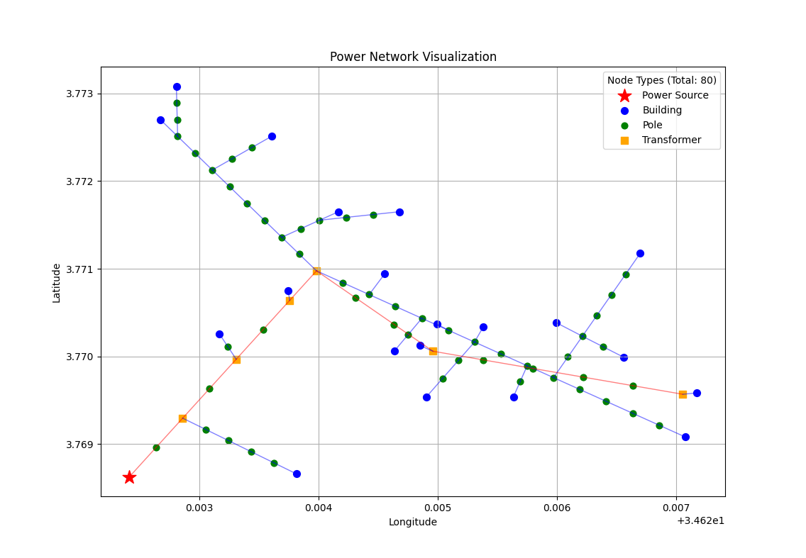
Directed Acyclic Graph
Parameterization
We can parameterize the graph using the DAG-tree subject to the constraints of the problem: Costs for all poles (with and without transformers) and cables, mv cables for power sources and transformers, lv cables for basic poles to poles and poles to buildings, and mv & lv cable distances
Demo

Slide 9
Graph Neural Networks
Uses
Since we can turn the problem into a graph representation, we can make use of graph NNs
This allows us to use ML to optimize the problem subject to multiple constraints
Pros / Cons
The graph NN gives us an easily digestible structural representation of a NN, while allowing for multiple data features to be internalized in a single node / edge – GD can do the optimization for you!
If unbounded, the state space can grow exponentially, leading to compute constraints
We chose the GCN because of ease of use and understanding vs the GAT

Slide 10
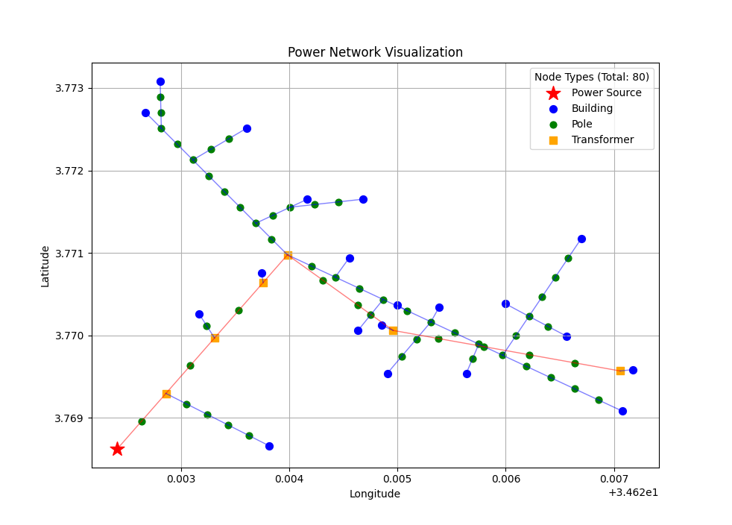
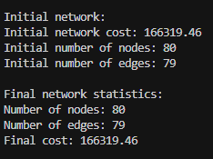
Graph convolutional network
Current Challenges
No training data for GCN, requiring novel way to calculate / minimize cost for the network via a reinforcement learning technique
No testing data to verify correctness of algorithm
Time constraints – this scale of a problem combined with the requirements for the class has proved difficult!
Further Testing
Replacing loss function with cost minimizing function in basic GCN
Using reinforcement learning
Incorporating shortest-path optimization for voltage drop

Slide 11
Website
In addition to our efforts for finding a solar mini-grid design optimization solution, we created an interactive component to our website to help broader audiences understand the context of our problem. We added a ‘Project’ tab to our website where users may input their own test data and receive a visual of an ‘optimal’ grid design and total cost as output. This way, users can get a feel for what input and output for this problem might even look like and better understand the challenge. More details on what this looks like are in the following slides.
We also made sure to consider our peer feedback on this new feature of the website, and ended up adding more context in the ‘Project’ tab’s description that would hopefully better prepare users to interact with it.

Slide 12
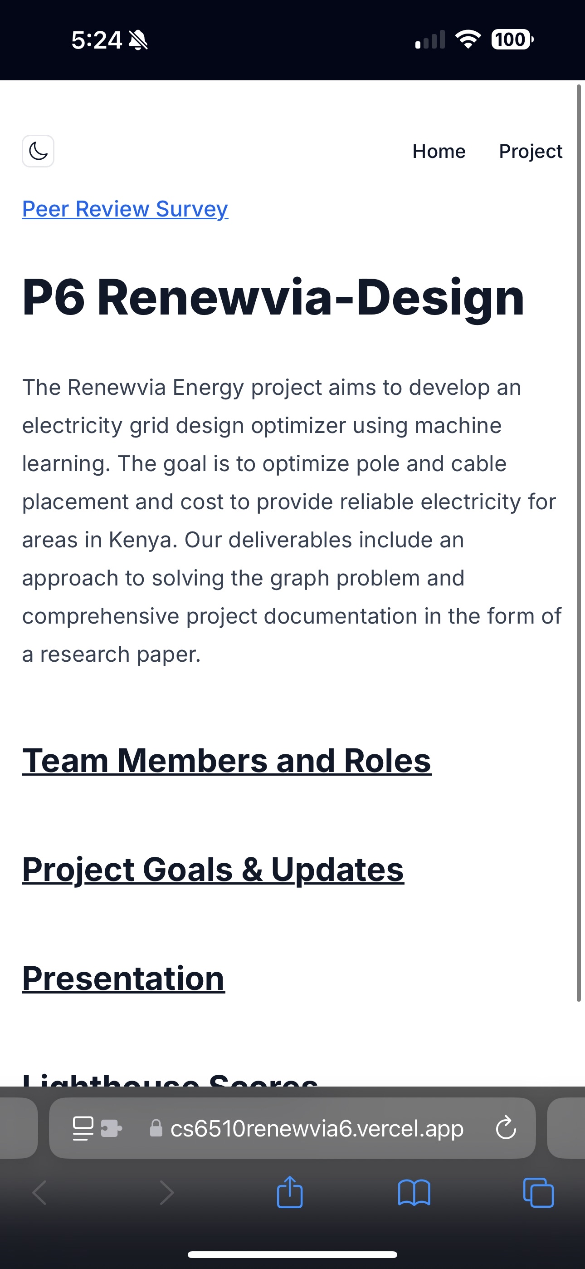

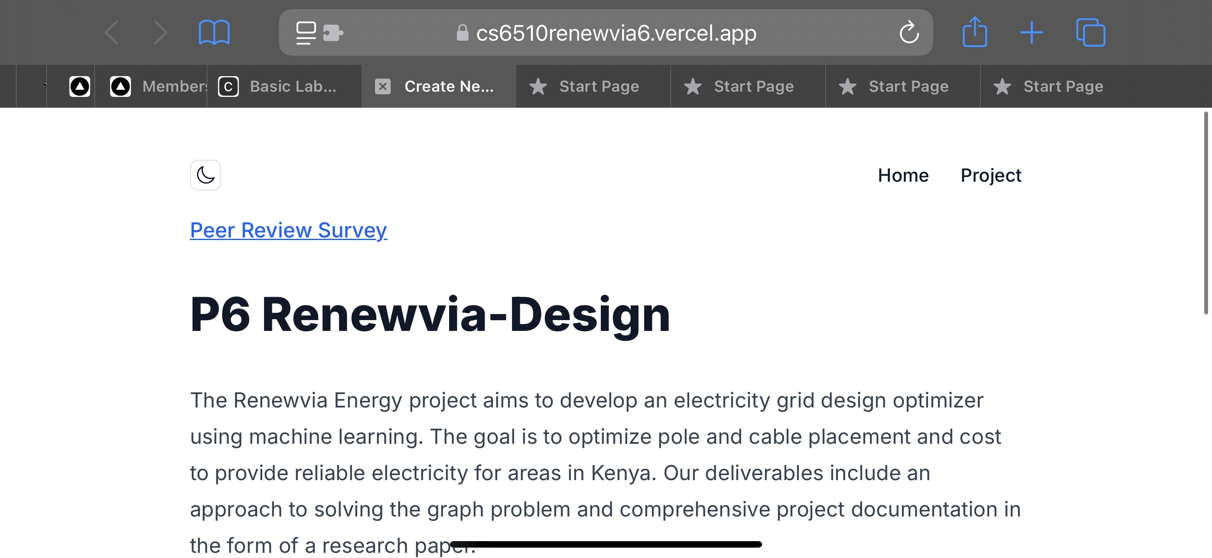
Project Home Pages
https://cs6510renewvia6.vercel.app/

Slide 13
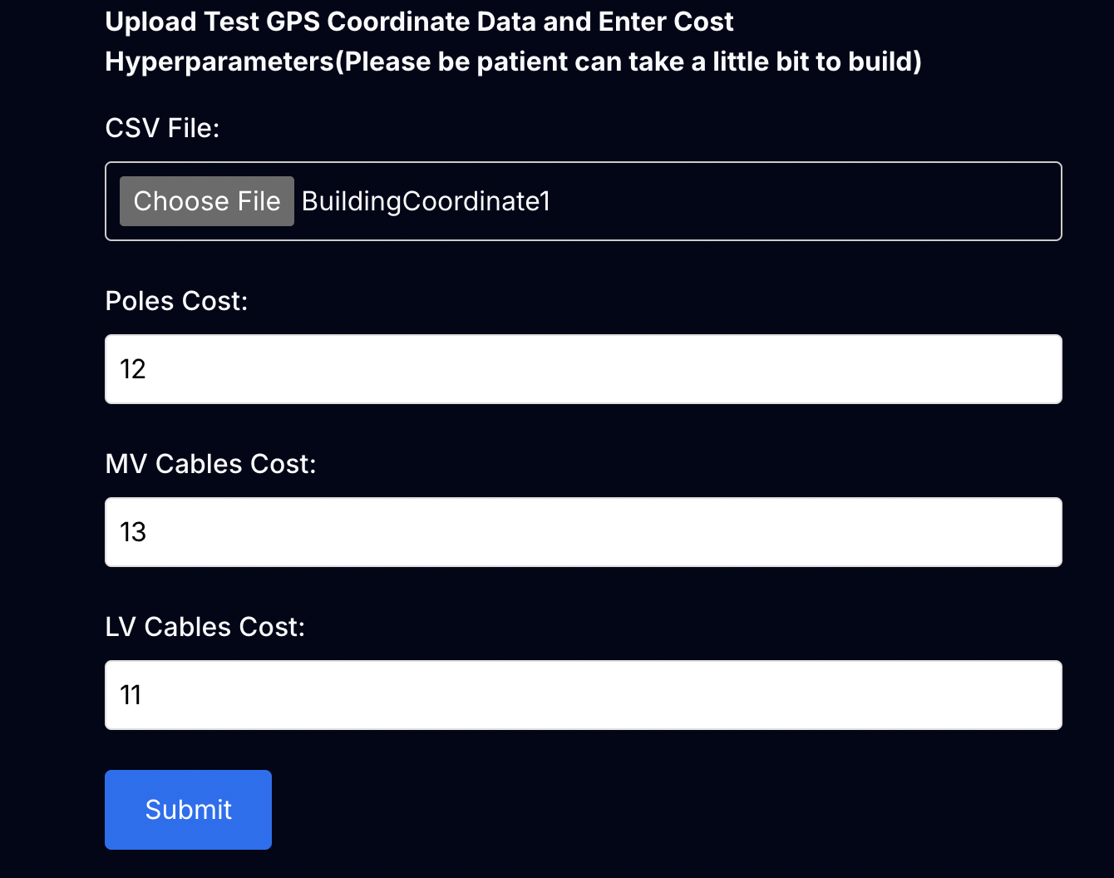
website project tab
User Input:
CSV file with building & power source coordinates (lat, long)
Hyperparameters: Poles Cost, MV Cables Cost, LV Cables Cost
Grid building and cost calculation logic:
Based on building locations from csv file, determine the number of poles and apply Kmeans algorithm to find initial pole locations. Then, make sure there's pole within 3-20 meters of every building.
Use minimum spanning tree algorithm to make sure grid design is acyclical and favors minimum total cable distance. Here, it also looks to split any edge that's longer than 50 meters by placing intermediate poles.
Based on the final grid design, determine the number of poles, MV cables (cable > 30 meters), LV cables (cables <= 30 meters). Multiply them by the costs hyperparameters input by user to calculate the total cost.

Slide 14
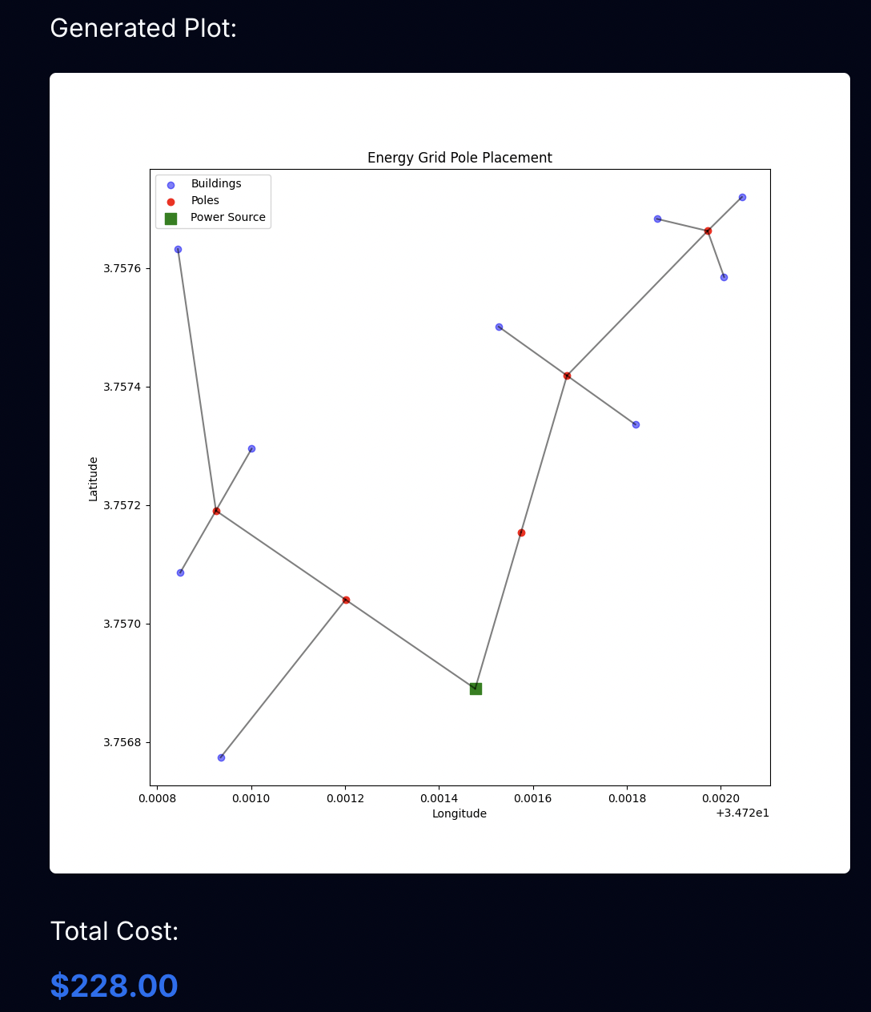
website project tab
Output:
Graph for grid design with different nodes representing buildings, a power source, and poles. Edges represent cables connecting the buildings, poles and power source. It also outputs the total cost for the grid design below the visual.

Slide 15
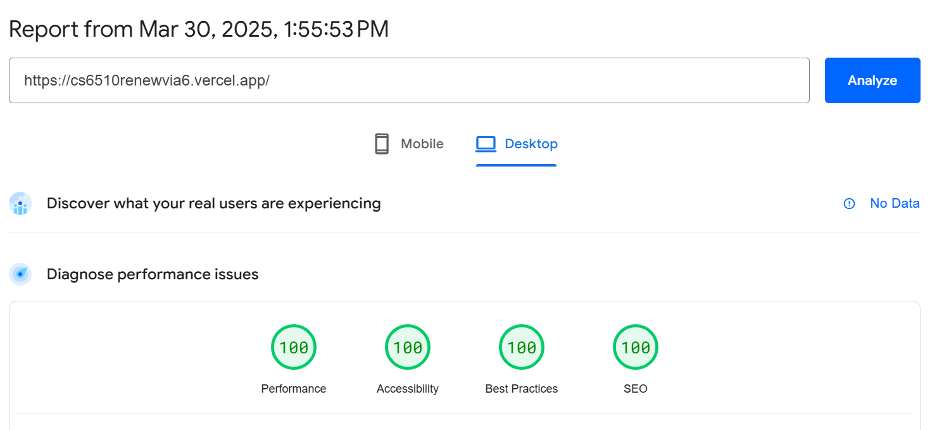
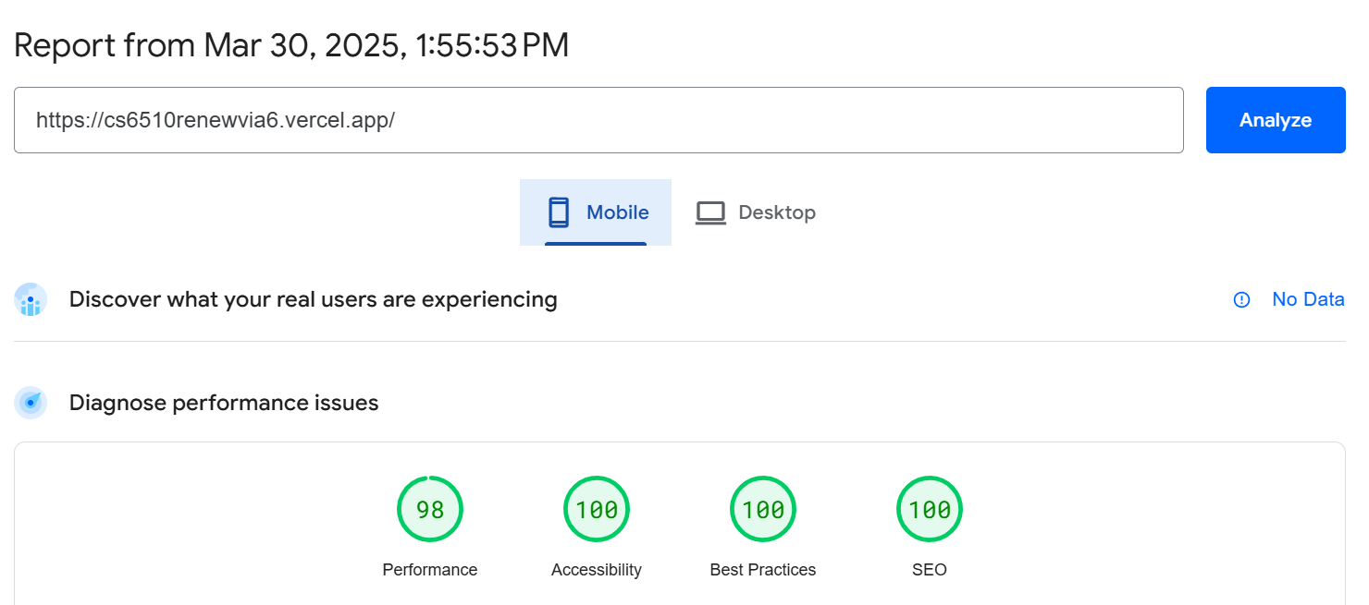
Homepage lighthouse scores
Desktop
Mobile

